Slide 1
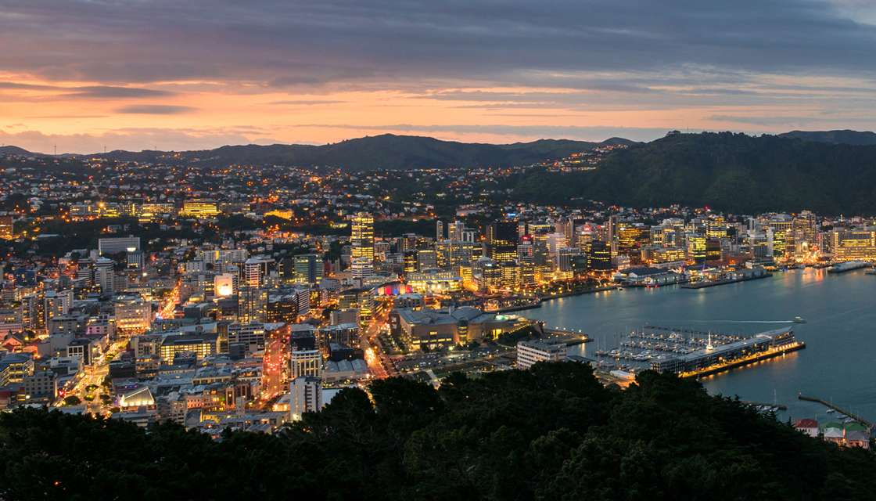
Kia Ora & Ni sa Bula Vinaka Mai Te-Whanganui-a-Tara

Slide 2
‘Voices & Memories’: Traditional Oral History –Indigenous Fijians
Indigenous Fijian Ancestors handed down Fijian Language, Indigenous Knowledge, Stories, Myths, Chants, Poems via Oral Indigenous Fijian Traditions.
It is an inherent quality or precious ‘Memory Code’ if not nurtured, will face extinction. Oral History safeguards this.
Indigenous Fijians in Rural Villages preserve these qualities. However, its being eroded by unsavoury forces/economic spin.
Vinaka vakalevu - Deuba Choir/Fijian Cultural Group from Fiji. Shortly, will perform & showcase our Oral Indigenous Fijian Traditions via Chants & ‘Meke’ & a modern take as, Choir.

Slide 3
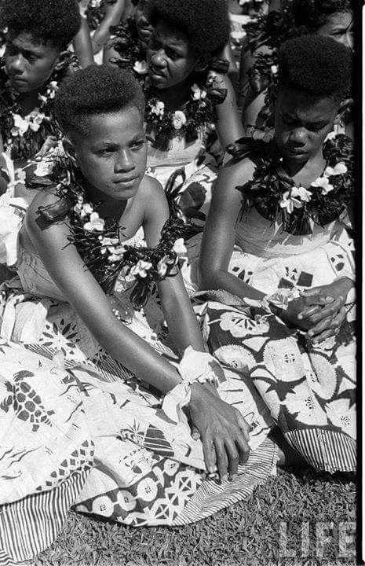
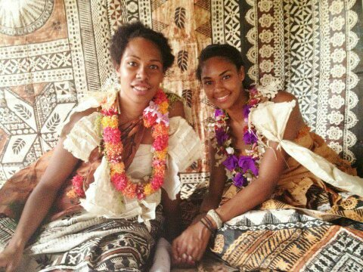
Indigenous Knowledge Gets Passed Down to the Younger Generation.

Slide 4
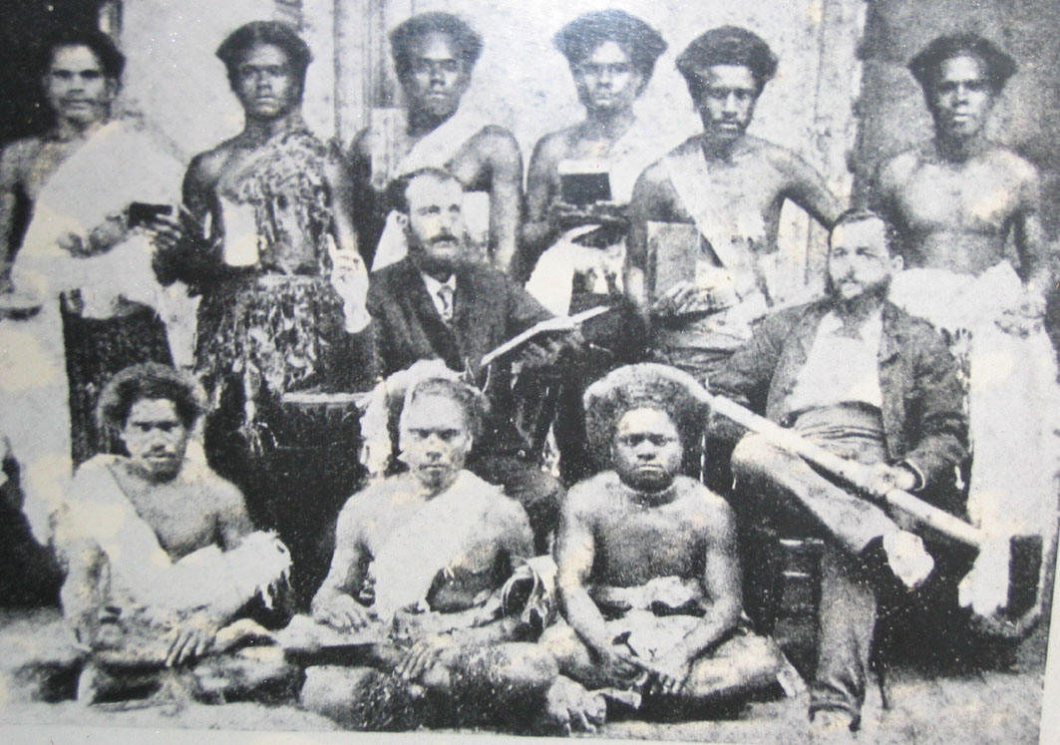
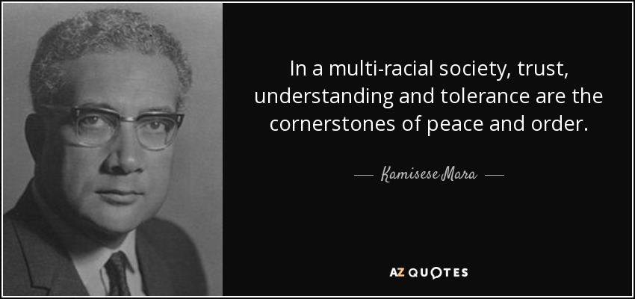
Oral Indigenous Cultural/Heritage Knowledge is Power. Elders earn their way to acquire these deep sacred knowledge.
Notes:
First lot of Indigenous Fijians trained as Medical Doctors.
Ratu Sir Kamisese Mara – Fiji’s Founding Father of Democracy & 1st PM & Paramount Chief of Lau Province in Fiji.
Indigenous Fijians like other most Indigenous Oral Culture must go through & pass lots of initiation to attain these deep knowledge.

Slide 5
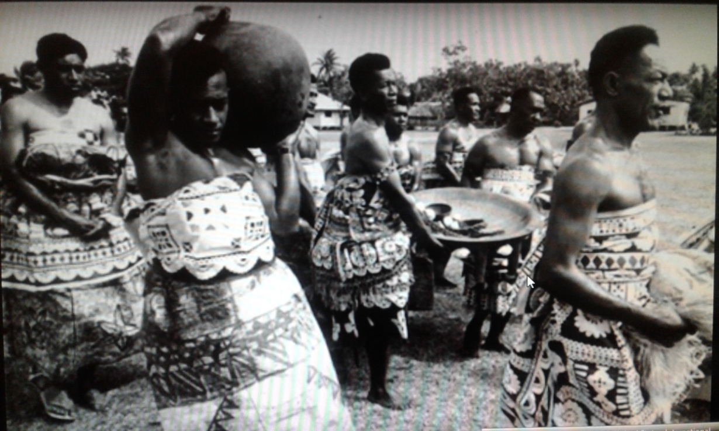
GROWTH
Importantly, Indigenous Knowledge passed down are preserved & often guarded as sacred by those who act as Traditional Custodians & proven their worth.
These can be noted at several layers within our Indigenous Fijian Social Structure.
These still exists today. One would have to have eyes & ears for details to distinguish these often deeply guarded secrets.

Slide 6
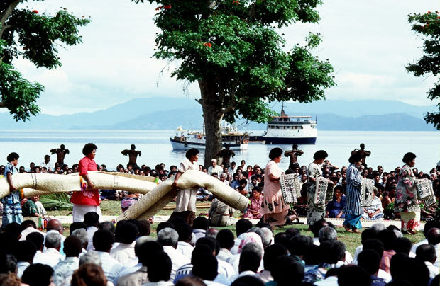
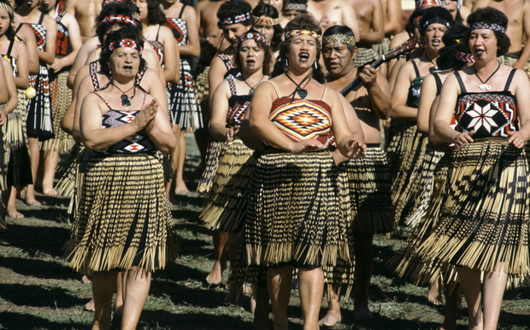
“Na Voqa ni Domo: The Sound of Voices Stringed with Pearls of Knowledge.”
FIJI & AOTEAROA - NEW ZEALAND
Notes:
This is the header for my Oral History Presentation to be given at the NZ Annual Oral History Association Conference late November 2018, in Hamilton. Here’s an excerpt of the abstract; “Listening to voices spoken in my Indigenous Fijian Language during Oral History interviews I conducted in Aotearoa, have been one of those most fulfilling journey. The sound, the pronunciation, the choice of vocabularies, stringing sentences and the narratives shared by the interviewees are rich reminders of the ‘pearls of knowledge’ embedded in their stories.” Adding in the training I received in Oral History by experts on techniques and technical requirements are indeed bonus in capturing riveting Memories & Voices of those encounter during my journey as an Oral Historian Researcher. Aotearoa New Zealand allows us to do this. Tena Koutou, Tena Kotou, Tena Tatou Katoa.

Slide 7
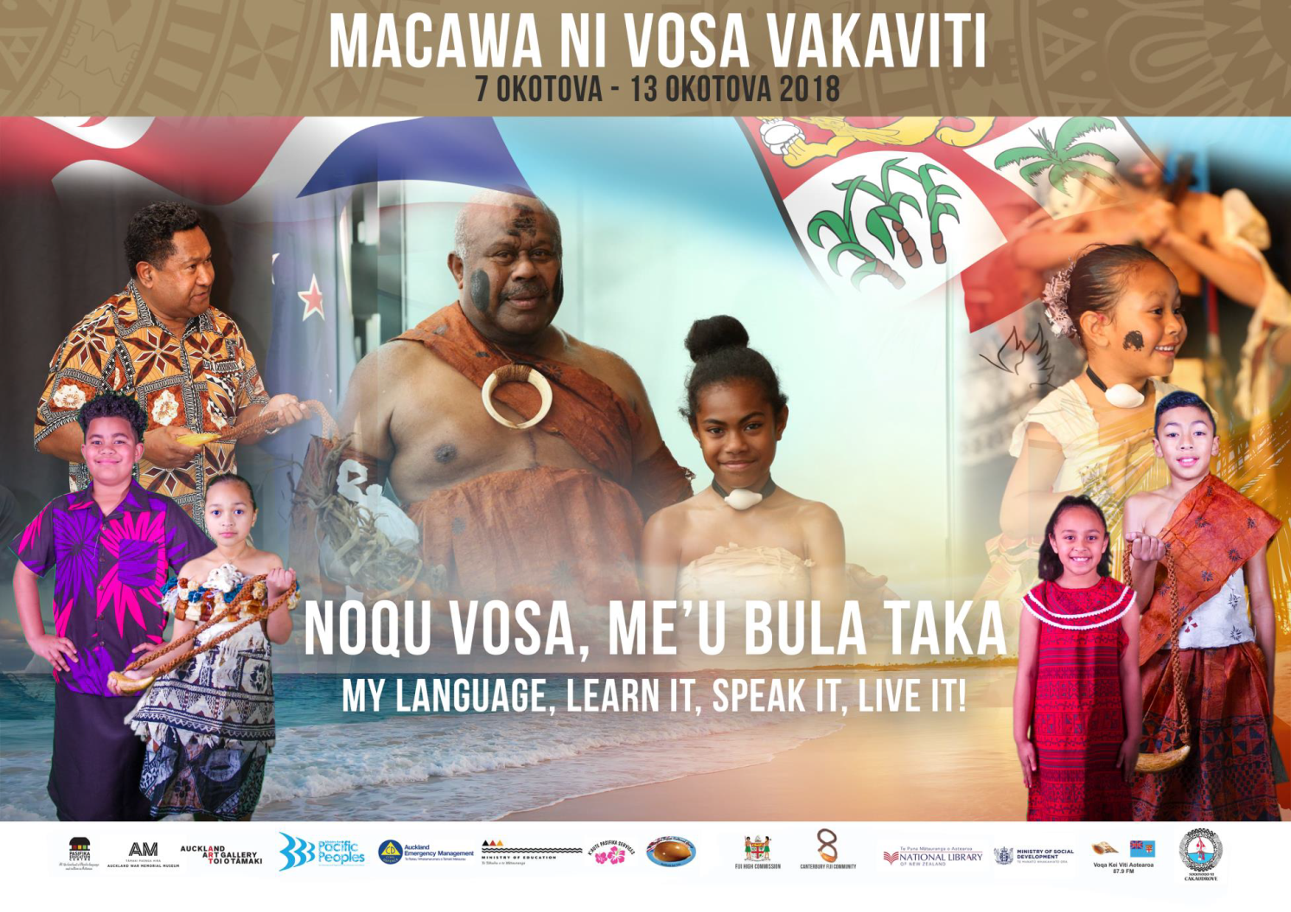
Vinaka Vakalevu & Tena Koutou, Tena Koutou, Tena Tatou Katoa.
Notes:
Vinaka vakalevu to the Team at National Library; Roger Swanson, Shane Gosner & his Team for giving us this space both for the Fijian Language Week Launch on Saturday October 6^{th,} 2018 & today’s event Thursday 11th October, 2018.
To the Ministry of Pacific Peoples for making the Fijian Language Week 2018 happen in Aotearoa.
To all our Sponsors noted at the bottom of our banner, Vinaka.
To the Deuba Choir/Fijian Cultural Group from Fiji for your wonderful performances and being with us.
To all of you who have supported us by your presence – Vinaka Vakalevu.
Last but not least to our hardworking Chair & the Fijian Language Week Komiti 2018 – Vinaka & Ka Kite.

